Slide 1
My Dream Roadtrip

Slide 2
Home
Map
Hikes
Food
Media

Slide 3

Home
Map
Hikes
Food
Media
Hi I am Cletus Dorfburg! and I am going to be mapping out my roadtrip journey through that southwest starting in phoenix. Blah blah blah!
Insert pretty image here

Slide 4
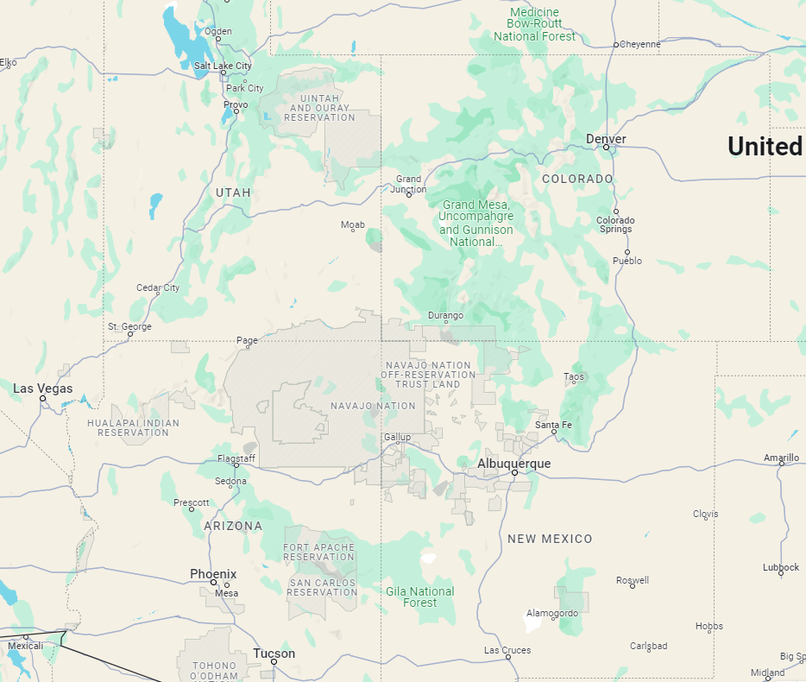
Map
Map
Hikes
Food
Media
The plan is to start in phoenix blah blah blah blah blah blah

Slide 5
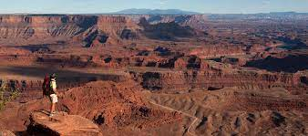
Hikes
Map
Hikes
Food
Media

Slide 6

Food
Map
Hikes
Food
Media

Slide 7


Media
Map
Hikes
Food
Media
Use #Roadtripdesert to share your route and experiences input your media here!
First Name
Last Name
Username
Platform

